Slide 1
UNIT-II
Database Design
Design process
Entity Relation Model
ER diagram
Keys , Attributes and Constraints
Mapping Cardinality
Extended ER - Generalization,
Specialization and Aggregation
ER Diagram Issues
Weak Entity
Relational Model
Conversion of ER to Relational Table

Slide 2
Course Learning Rationale (CLR)
Conceive the database design process through ER Model and Relational Model
Course Learning Outcomes (CLO)
Apply the fundamentals of data models to model an application’s data requirements using conceptual modeling tools like ER diagrams

Slide 3
Database Design
design of database schema. (how database will be structured to fulfill the requirements)
Design Process:
characterize data needs of users.
*designer ->interact extensively with domain experts & users
*outcome is specification of user requirements.
designer chooses a data model,
*translates these requirements into a conceptual schema of
database.
*designer reviews the schema to confirm that all data
requirements are not in conflict with one another.
Remove any redundant.
describing the data and their relationships

Slide 4
conceptual-design process involves decisions on :
“what attributes”
“how to group” these attributes to form various tables.
“what” part is basically a business decision
“how” part is mainly a computer-science problem. Two ways to tackle the problem:
Entity-Relationship model
Set of algorithms (Normalization)

Slide 5
Designer review Functional requirements of the
enterprise:
users describe kinds of operations (or transactions)
that will be performed on data.
In logical-design phase designer maps the high-
level conceptual schema onto the implementation
data model of the database system.
Designer uses schema in subsequent physical-
design phase, in which physical features of
database are specified.

Slide 6
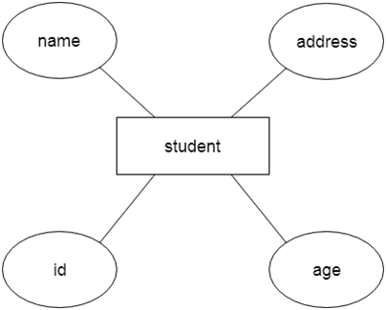
Entity Relation Model[ER model]:
Define data elements and relationship.
Develops conceptual design for database.
Develops design view of data.
In ER modeling database structure is portrayed as a diagram called an entity-relationship diagram.

Slide 7
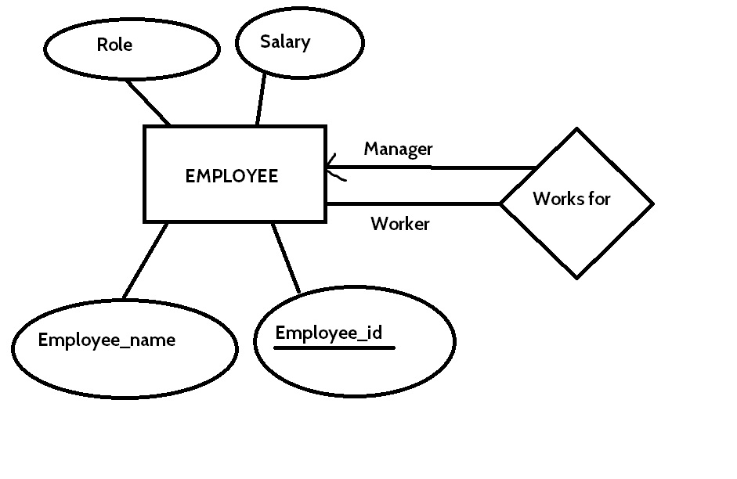
Entity role

Slide 8
ER Diagrams Symbols & Notations
Entity Relationship Diagram Symbols & Notations mainly contains three basic symbols which are rectangle, oval and diamond to represent relationships between elements, entities and attributes. There are some sub-elements which are based on main elements in ERD Diagram. ER Diagram is a visual representation of data that describes how data is related to each other using different ERD Symbols and Notations.
Following are the main components and its symbols in ER Diagrams:
Rectangles: This Entity Relationship Diagram symbol represents entity types
Ellipses : Symbol represent attributes
Diamonds: This symbol represents relationship types
Lines: It links attributes to entity types and entity types with other relationship types
Primary key: attributes are underlined
Double Ellipses: Represent multi-valued attributes

Slide 9
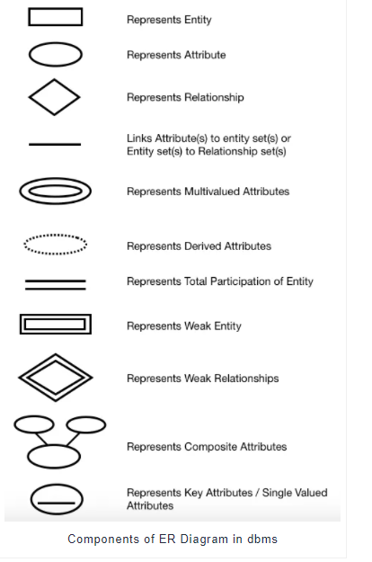

Slide 10
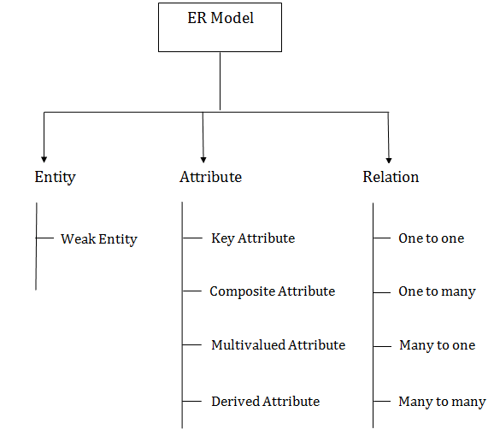
Component of ER Diagram

Slide 11


1. Entity:
An entity may be any object, class, person or place.
represented as rectangles.
Consider an organization as an example- manager, product, employee, department etc. can be taken as an entity.
(i) Weak Entity:
depends on another entity
doesn't contain any key attribute of its own.
represented by a double rectangle.

Slide 12
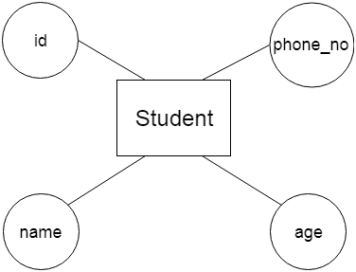
2. Attribute:
describe the property of an entity.
Eclipse is used to represent an attribute.

Slide 13
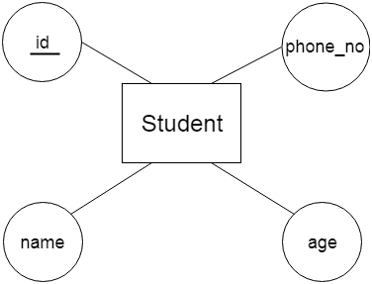
(i)Key Attribute:
Represent main characteristics of an entity.
It represents a primary key.
represented by an ellipse with the text underlined.

Slide 14
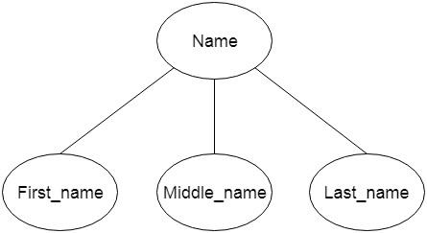
(ii)Composite Attribute:
composed of many other attributes
represented by an ellipse, and those ellipses are connected with an ellipse.

Slide 15
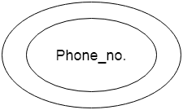
(iii)Multivalued Attribute:
can have more than one value.
double oval is used to represent multivalued attribute.
For example, a student can have more than one phone number.
.

Slide 16
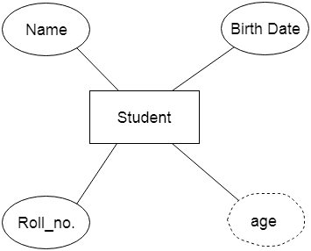
(iv)Derived Attribute:
derived from other attribute
represented by a dashed ellipse.

Slide 17


3. Relationship:
Describe relation between entities.
Diamond or rhombus is used to represent relationship.
Types of relationship:
(i)One-to-One Relationship:
only one instance of an entity is associated with the relationship
.

Slide 18


(ii)One-to-many relationship:
only one instance of entity on left and more than one instance of entity on right associates with relationship
(iii)Many-to-one relationship:
More than one instance of entity on left and only one instance of entity on right associates with the relationship

Slide 19

(iv)Many-to-many relationship:
More than one instance of entity on left and more than one instance of an entity on right associates with the relationship
Notation of ER diagram:

Slide 20
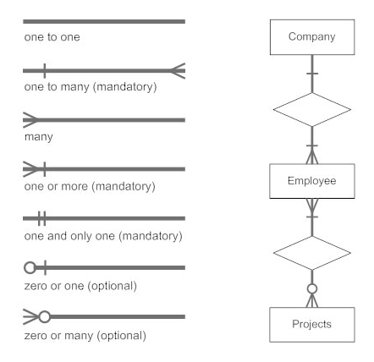

Slide 21
Constraints
Constraints are used for modeling limitations on the relations between entities.
There are two types of constraints on the Entity Relationship (ER) model −
Mapping cardinality or cardinality ratio.
Participation constraints.

Slide 22
Mapping Constraints:
mapping constraint is a data constraint that express the number of entities to which another entity can be related via a relationship set.
It is most useful in describing relationship sets that involve more than two entity sets.
For binary relationship set R on an entity set A and B, there are four possible mapping cardinalities:
One to one (1:1)
One to many (1:M)
Many to one (M:1)
Many to many (M:M)

Slide 23
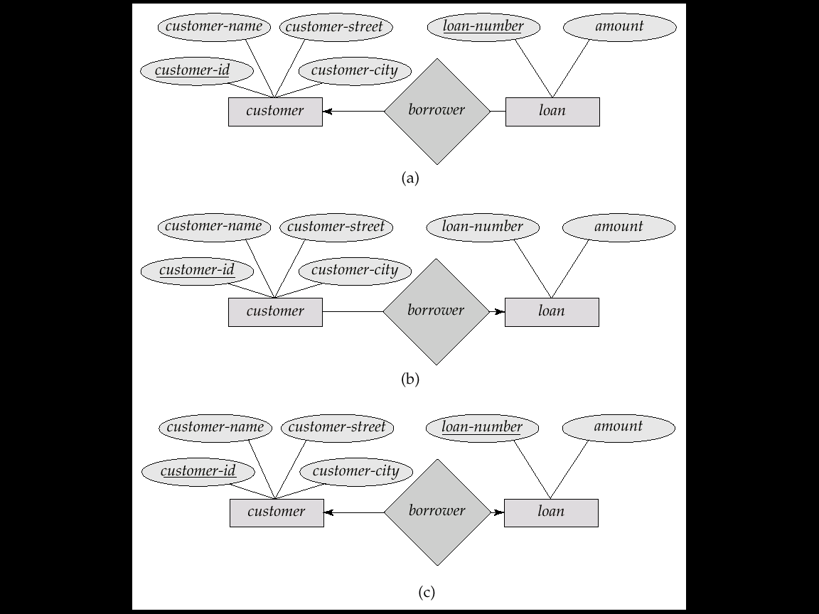
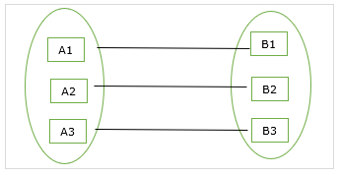
We express cardinality constraints by drawing either a directed line (→), signifying “one,” or an undirected line (—), signifying “many,” between the relationship set and the entity set.
One-to-one relationship
An entity set A is associated with at most one entity in B and an entity in B is associated with at most one entity in A.
A customer is associated with at most one loan via the relationship borrower
A loan is associated with at most one customer via borrower

Slide 24
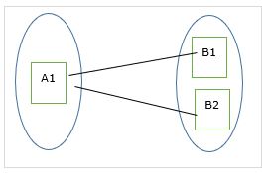
One-to-many relationship
An entity set A is associated with any number of entities in B with a possibility of zero and an entity in B is associated with at most one entity in A.
Example:
Loan is associated with at most one customer via borrower,
customer is associated with several (including 0) loans via borrower

Slide 25
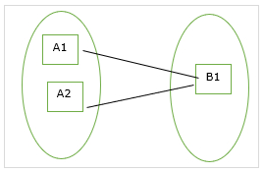
Many-to-one relationship
An entity set A is associated with at most one entity in B and an entity set in B can be associated with any number of entities in A with a possibility of zero.
Example:
loan is associated with several (including 0) customers via borrower,
customer is associated with at most one loan via borrower

Slide 26
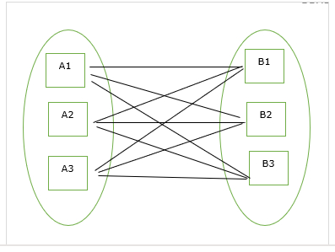
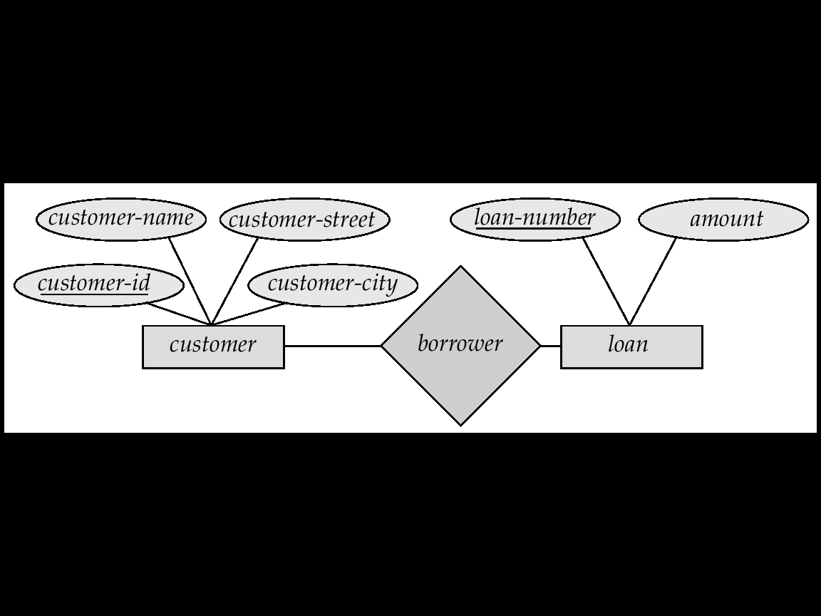
Many-to-many relationship
An entity set A is associated with any number of entities in B with a possibility of zero and an entity in B is associated with any number of entities in A with a possibility of zero.
Example:
A customer is associated with several (possibly 0) loans via borrower
A loan is associated with several (possibly 0) customers via borrower

Slide 27
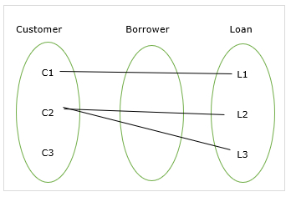
Participation Constraints
Participate constraints are two types as mentioned below −
Total participation
Partial Participation
The participation constraints are explained in the diagram below −
Here,
customer to Loan - partial participation
loan to customer - total participation.

Slide 28
Total participation
The participation of an entity set E in a relationship set R is said to be total if every entity in E Participates in at least one relationship in R.
For Example − Participation of loan in the relationship borrower is total participation.
Partial Participation
If only some of the entities in E participate in relationship R, then the participation of E in R is said to be partial participation.
For example − Participation of customers in the relationship borrower is partial participation.

Slide 29
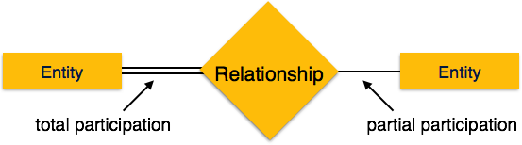
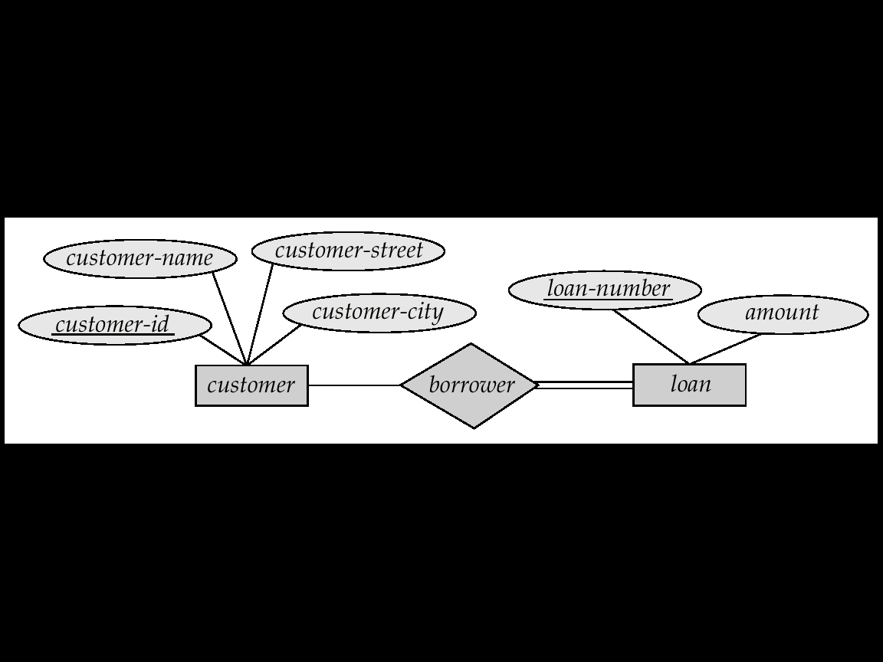

Slide 30
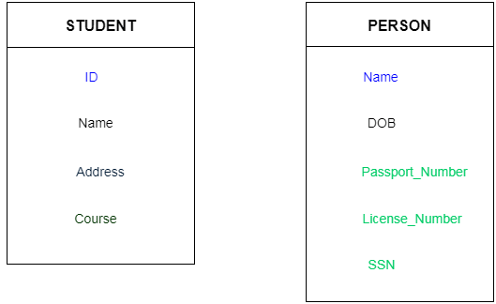
Keys:
used to uniquely identify any record or row of data from the table.
used to establish and identify relationships between tables.
For example: In Student table, ID is used as a key because it is unique for each student. In PERSON table, passport_number, license_number, SSN are keys since they are unique for each person.

Slide 31
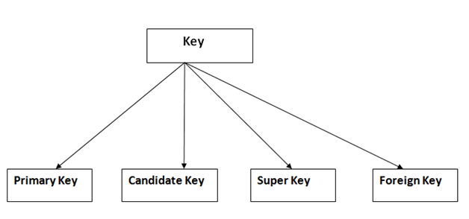
Types of key:

Slide 32
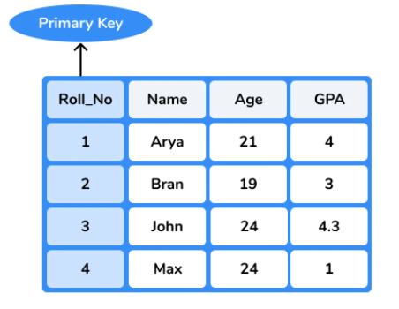
1. Primary key:
used to identify one and only one instance of an entity uniquely.
entity can contain multiple keys .The key which is most suitable from those lists become a primary key.
For each entity, selection of primary key is based on requirement and developers.

Slide 33
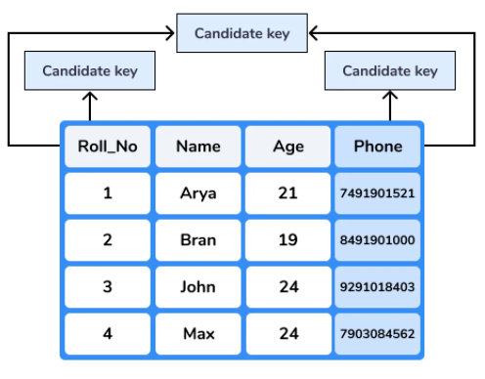
2. Candidate key:
is an attribute or set of an attribute which can uniquely identify a tuple.
Remaining attributes except for primary key are candidate key. candidate keys are as strong as primary key.

Slide 34
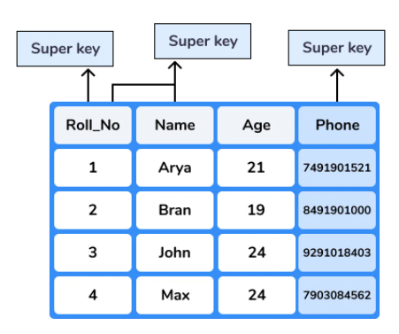
3. Super Key:
is a set of an attribute which can uniquely identify a tuple.
Super key is a superset of a candidate key.

Slide 35
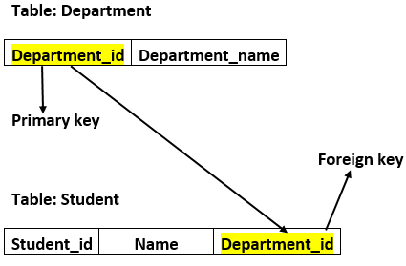
4. Foreign key:
A foreign key is an attribute in one table that acts as a primary key in another table. The foreign key is useful for establishing the relationship between two tables in a database.
In a college, every student study in a specific department, and department & student are two different entities. So you cannot store the information of the student in the department table. That’s why we relate these two tables using the primary key of one table.

Slide 36
Mapping Cardinality:
For binary relationship set R on an entity set A and B, there are four possible mapping cardinalities:
One to one (1:1)
One to many (1:M)
Many to one (M:1)
Many to many (M:M)

Slide 37
Extended ER – Generalization:
Is bottom-up approach in which two or more entities of lower level combine to form a higher level entity if they have some attributes in common.
an entity of a higher level can also combine with the entities of the lower level to form a further higher level entity.
is more like subclass and superclass system
subclasses are combined to make a superclass.
For example, Faculty and Student entities can be generalized and create a higher level entity Person.

Slide 38
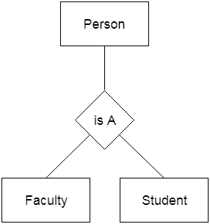

Slide 39
Specialization:
is a top-down approach and it is opposite to Generalization.
In specialization, one higher level entity can be broken down into two lower level entities.
used to identify subset of an entity set that shares some distinguishing characteristics.
superclass is defined first, subclass and its related attributes are defined next and relationship set are then added.
For example: In an Employee management system, EMPLOYEE entity can be specialized as TESTER or DEVELOPER

Slide 40
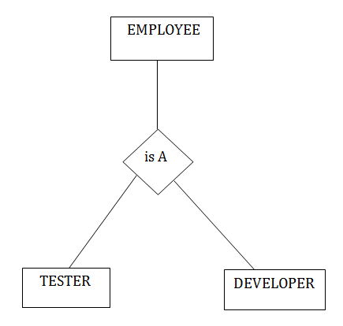

Slide 41
Aggregation:
relation between two entities is treated as a single entity.
relationship with its corresponding entities is aggregated into a higher level entity.
For example: Center entity offers the Course entity act as a single entity in relationship which is in a relationship with another entity visitor. In real world, if a visitor visits a coaching center then he will never enquiry about the Course only or just about the Center instead he will ask the enquiry about both.

Slide 42
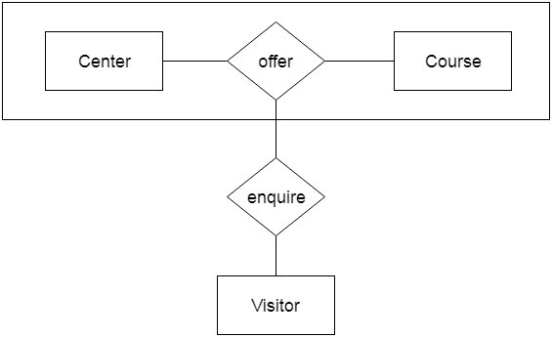

Slide 43
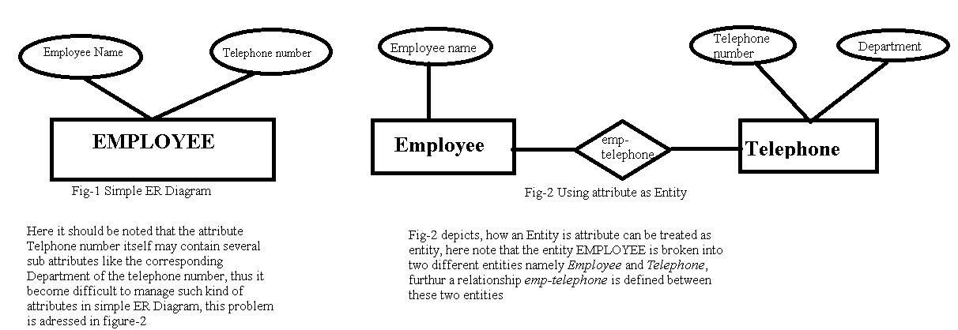
ER Design Issues:
1) Use of Entity Set vs Attributes
The use of an entity set or attribute depends on structure of real-world enterprise that is being modeled and semantics associated with its attributes.
It leads to mistake when user use primary key of an entity set as an attribute of another entity set.
Instead, he should use relationship to do so. Also, primary key attributes are implicit in relationship set, but we designate it in relationship sets.

Slide 44
Consider the entity set employee with attributes employee-name and telephone-number. It can easily be argued that a telephone is an entity in its own right with attributes telephone-number and location (the office where the telephone is located). If we take this point of view, we must redefine the employee entity set as: • The employee entity set with attribute employee-name • The telephone entity set with attributes telephone-number and location • The relationship set emp-telephone, which denotes the association between employees and the telephones that they have. Such a conversion of attribute helps to give extra information about it when required.

Slide 45
ER Design Issues:
2) Use of Entity Set vs. Relationship Sets
It is difficult to examine if an object can be best expressed by an entity set or relationship set.
To understand and determine right use, user need to designate a relationship set for describing an action that occurs in-between entities.
If there is a requirement of representing object as a relationship set, then its better not to mix it with entity set.

Slide 46
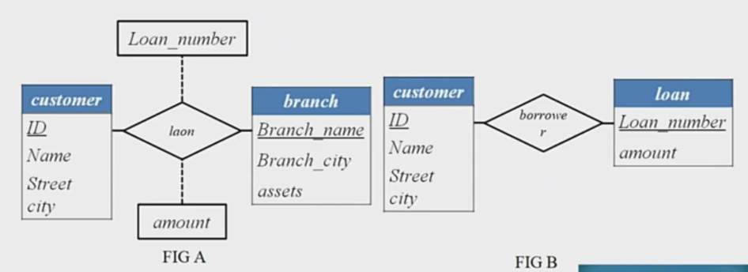

Slide 47
3) Use of Binary vs n-ary Relationship Sets
Generally, relationships described in databases are binary relationships.
non-binary relationships can be represented by several binary relationships.
In most cases the relationships in database system is binary which means it defines the relationship between two entities.
Sometimes a system may have non binary(more than 2) relations, under such design those non binary relations are broken down to several binary relationships which in turn gives an easy and better representation of the system.

Slide 48
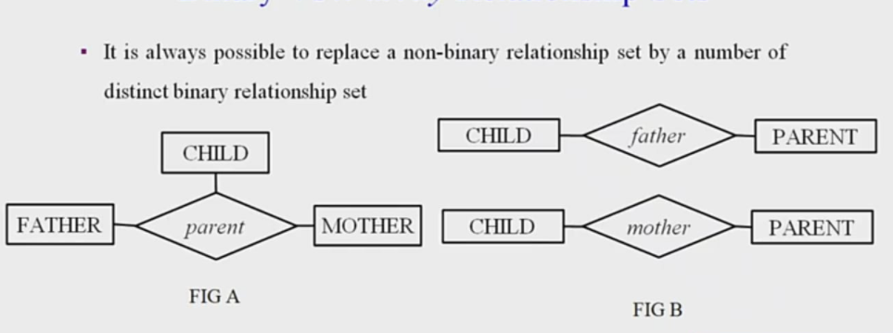
For example, we can create and represent a ternary relationship 'parent' that may relate to a child, his father, as well as his mother. Such relationship can also be represented by two binary relationships i.e, mother and father, that may relate to their child.
it is possible to represent a non-binary relationship by a set of distinct binary relationships.

Slide 49
4) Placing Relationship Attributes
The cardinality ratios can become an affective measure in placement of relationship attributes.
So, it is better to associate attributes of one-to-one or one-to-many relationship sets with any participating entity sets, instead of any relationship set.
The decision of placing specified attribute as a relationship or entity attribute should possess charactestics of real world enterprise that is being modelled.

Slide 50

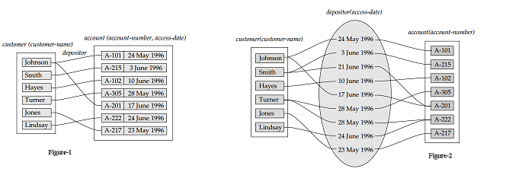

Slide 51
(i) Weak Entity:
depends on another entity
doesn't contain any key attribute of its own.
represented by a double rectangle.

Slide 52
Relational Model:
can represent as a table with columns and rows.
Each row is known as a tuple. Each table of the column has a name or attribute.
Domain:
It contains a set of atomic values that an attribute can take.
Attribute:
It contains the name of a column in a table. Each attribute Ai must have a domain, dom(Ai)
Relational instance:
Relational instance is represented by finite set of tuples.
Relation instances do not have duplicate tuples.
Relational schema: A relational schema contains the name of the relation and name of all columns or attributes.
Relational key: In the relational key, each row has one or more attributes. It can identify the row in the relation uniquely.

Slide 53
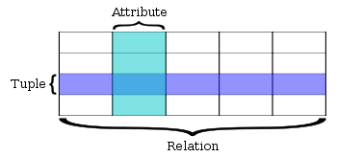
Example: STUDENT Relation

Slide 54
Example: STUDENT Relation
In the given table,
NAME, ROLL_NO, PHONE_NO, ADDRESS, and AGE
are the attributes.
Instance of schema STUDENT has 5 tuples.
t3 = <Laxman, 33289, 8583287182, Gurugram, 20>
NAME | ROLL_NO | PHONE_NO | ADDRESS | AGE
Ram | 14795 | 7305758992 | Noida | 24
Shyam | 12839 | 9026288936 | Delhi | 35
Laxman | 33289 | 8583287182 | Gurugram | 20
Mahesh | 27857 | 7086819134 | Ghaziabad | 27
Ganesh | 17282 | 9028 9i3988 | Delhi | 40

Slide 55
Properties of Relations:
Name of relation is distinct from all other relations.
Each relation cell contains exactly one atomic (single) value
Each attribute contains a distinct name
Attribute domain has no significance
tuple has no duplicate value
Order of tuple can have a different sequence
Relational Algebra
is a procedural query language.
It gives a step by step process to obtain result of query.
It uses operators to perform queries.
Types of Relational operation

Slide 56
Relation schema − A relation schema describes the relation name (table name), attributes, and their names.
Relation key − Each row has one or more attributes, known as relation key, which can identify the row in the relation (table) uniquely.
Attribute domain − Every attribute has some pre-defined value scope, known as attribute domain.

Slide 57
Constraints
Every relation has some conditions that must hold for it to be a valid relation. These conditions are called Relational Integrity Constraints. There are three main integrity constraints −
Key constraints
Domain constraints
Referential integrity constraints

Slide 58
Key Constraints
There must be at least one set of attributes that can identify a tuple in a unique manner. This set is known as a key.
There must be at least one minimal subset of attributes in the relation, which can identify a tuple uniquely. This minimal subset of attributes is called key for that relation. If there are more than one such minimal subsets, these are called candidate keys.1 to n
Key constraints force that −
in a relation with a key attribute, no two tuples can have identical values for key attributes.
a key attribute can not have NULL values.
Key constraints are also referred to as Entity Constraints.

Slide 59
Domain Constraints
Attributes have specific values in real-world scenario. For example, age can only be a positive integer. The same constraints have been tried to employ on the attributes of a relation. Every attribute is bound to have a specific range of values. For example, age cannot be less than zero and telephone numbers cannot contain a digit outside 0-9.
There are some domain specific constraints that must be followed in a database. Example - The salary of an employee cannot be negative so the salary field has only positive values.

Slide 60
Referential integrity Constraints
Referential integrity constraints work on the concept of Foreign Keys. A foreign key is a key attribute of a relation that can be referred in other relation.
Referential integrity constraint states that if a relation refers to a key attribute of a different or same relation, then that key element must exist.
These constraints are used to describe the behaviour of foreign keys. A foreign key is a key of a relation that can be referred in another relation.

Slide 61
Converting ER Diagrams to Tables-
ER diagram is converted into the tables in relational model.
This is because relational models can be easily implemented by RDBMS like MySQL , Oracle etc.
Rule-01: For Strong Entity Set With Only Simple Attributes-
A strong entity set with only simple attributes will require only one table in relational model.
Attributes of the table will be the attributes of the entity set.
The primary key of the table will be the key attribute of the entity set.

Slide 62
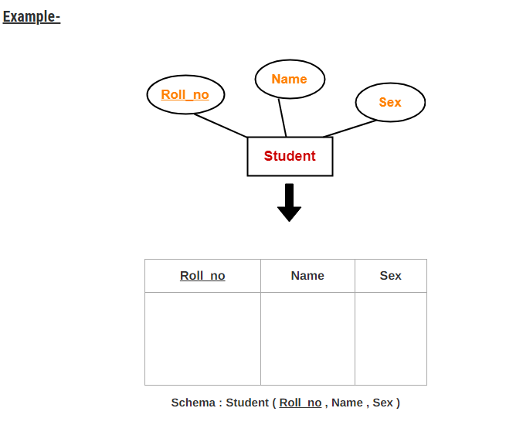

Slide 63
Rule-02: For Strong Entity Set With Composite Attributes-
A strong entity set with any number of composite attributes will require only one table in relational model.
While conversion, simple attributes of the composite attributes are taken into account and not the composite attribute itself.

Slide 64
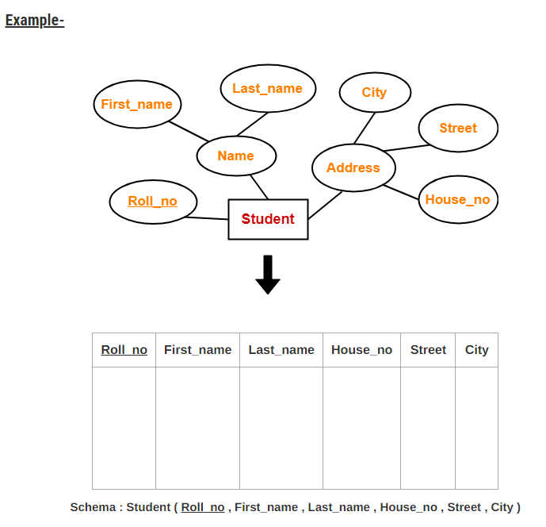

Slide 65
Rule-03: For Strong Entity Set With Multi Valued Attributes-
A strong entity set with any number of multi valued attributes will require two tables in relational model.
One table will contain all the simple attributes with the primary key.
Other table will contain the primary key and all the multi valued attributes.

Slide 66
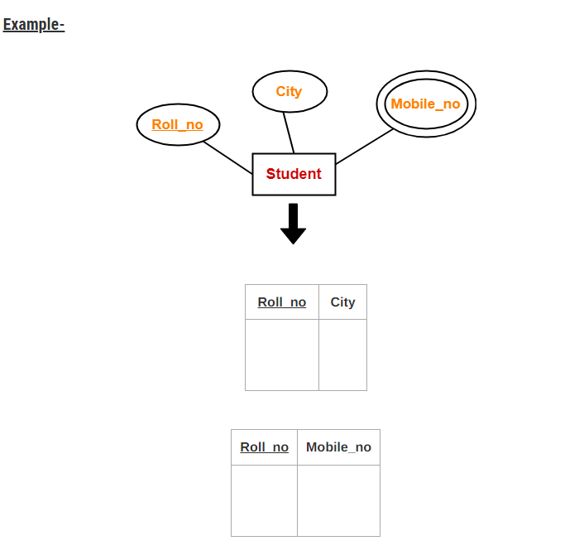

Slide 67
Rule-04: Translating Relationship Set into a Table-
A relationship set will require one table in the relational model.
Attributes of the table are-
Primary key attributes of the participating entity sets
Its own descriptive attributes if any.
Set of non-descriptive attributes will be the primary key.

Slide 68
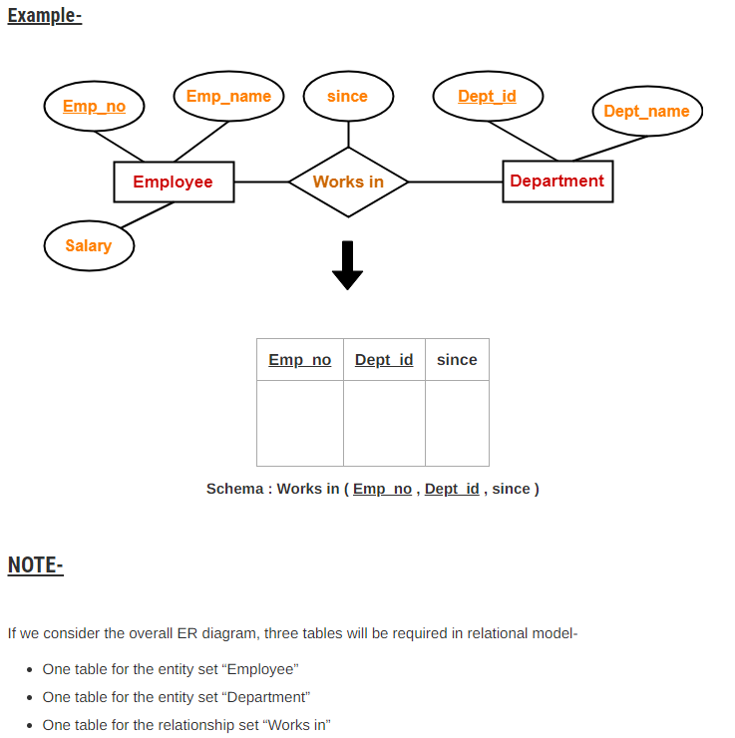

Slide 69
Rule-05: For Binary Relationships With Cardinality Ratios-
The following four cases are possible-
Case-01: Binary relationship with cardinality ratio m:n
Case-02: Binary relationship with cardinality ratio 1:n
Case-03: Binary relationship with cardinality ratio m:1
Case-04: Binary relationship with cardinality ratio 1:1

Slide 70
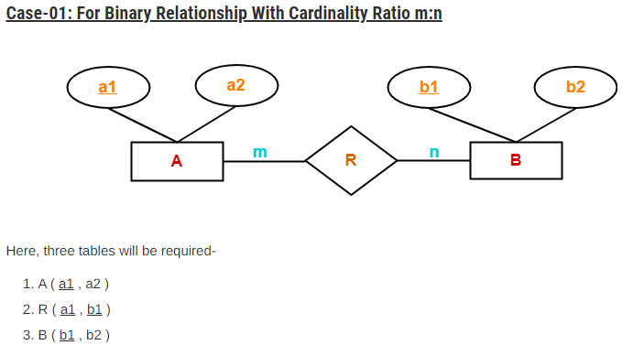

Slide 71
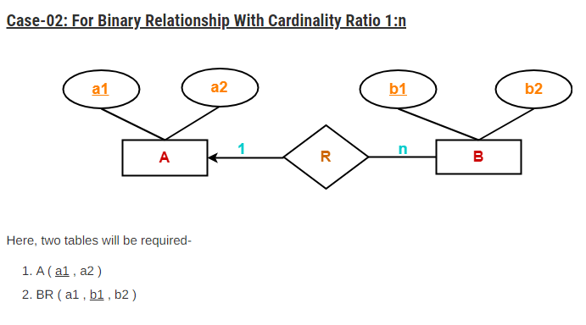
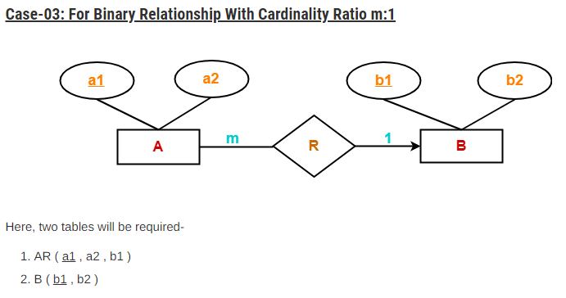

Slide 72
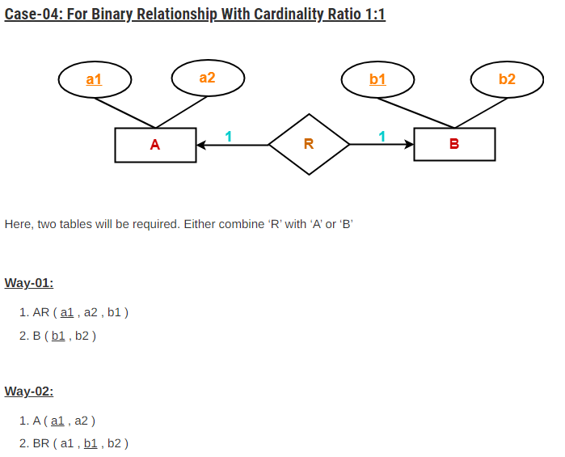

Slide 73
Rule-06: For Binary Relationship With Both Cardinality Constraints and Participation Constraints-
Cardinality constraints will be implemented as discussed in Rule-05.
Because of the total participation constraint, foreign key acquires NOT NULL constraint i.e. now foreign key can not be null.

Slide 74
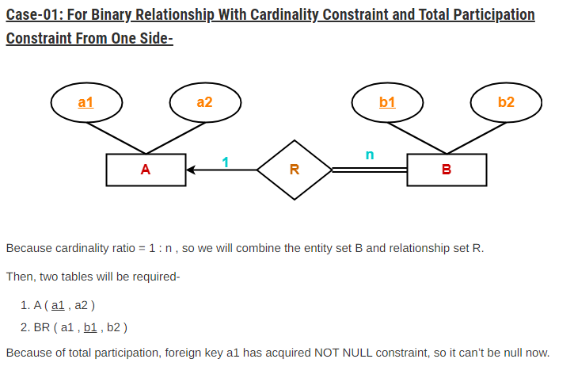

Slide 75
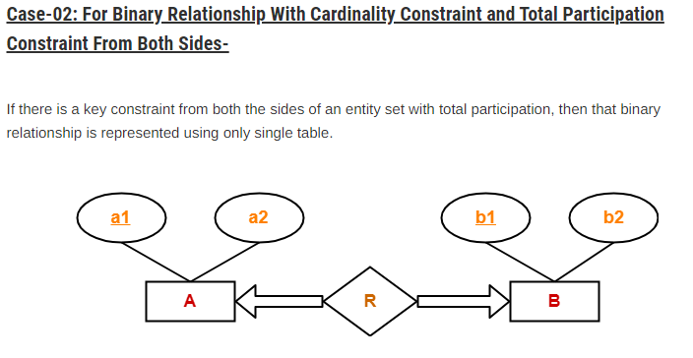
Here, Only one table is required.
ARB ( a1 , a2 , b1 , b2 )

Slide 76
